Slide 1

Hospital Database Management System
MySQL Case Study-Analysis
Akshitha Chittireddy-Data Analyst

Slide 2
Problem Statement : analysing the Hospital database and providing the crucial insights to the client and answers his queries
Hospitals are the most important part of our lives, trying to provide the best medical facilities to people suffering from various type of illness, which may be due to change in climate conditions, increased work-load, emotional trauma stress etc. It is very much difficult for the hospital to maintain its day-to-day activities and records manually. That is why a database is required to keep records of all type of activities of a hospital.

Slide 3
List of tables in the hospital database:
Physician
Department
Affiliated_with
Procedure
Trained_in
Patient
Nurse
Appointment
Medication
Prescribes
Block
Room
On_call
Stay
Undergoes

Slide 4
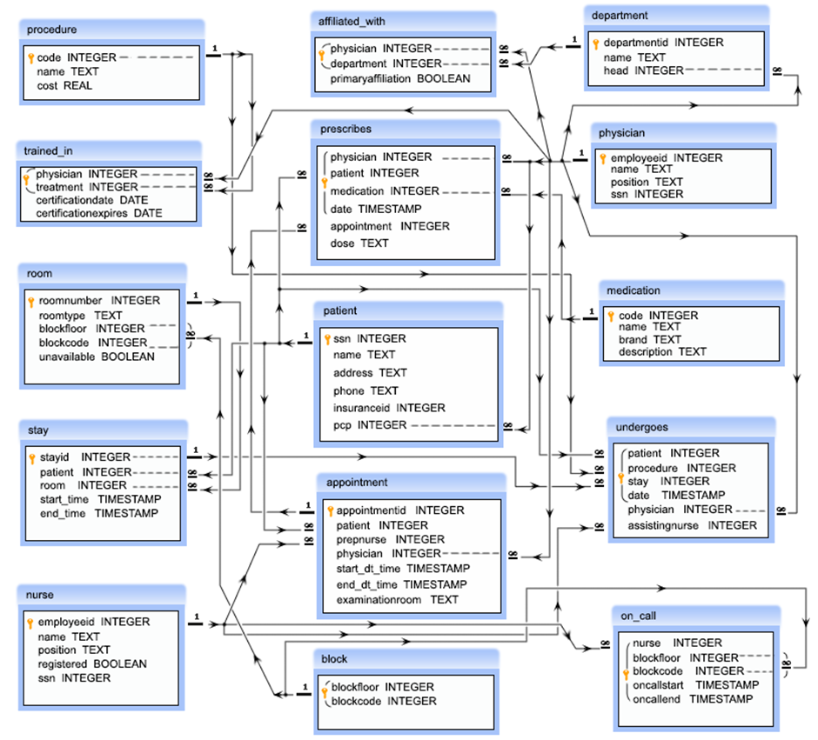
Entity Relationship Diagram (ERD)

Slide 5
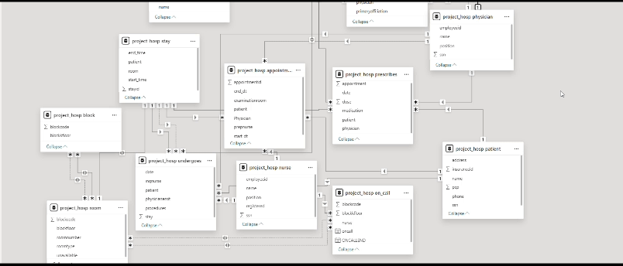

Slide 6
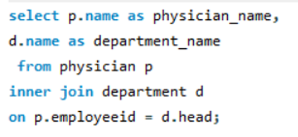
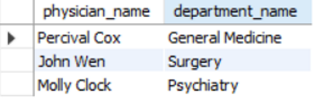
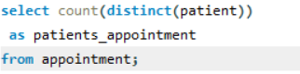
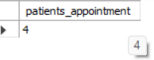

Name of the physicians who are the head of each department
Count the number of patients who taken appointment with at least one physician

Slide 7
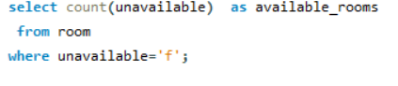
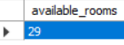
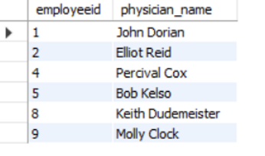
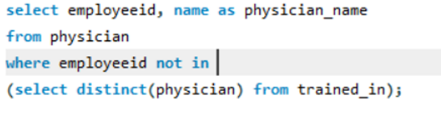
Count the number available rooms
Name of the physicians who are not a specialized physician

Slide 8
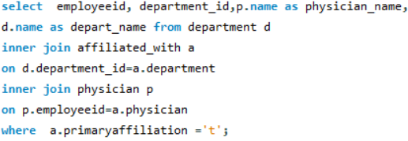
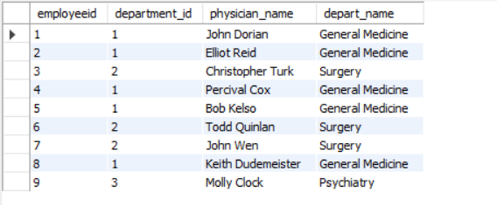
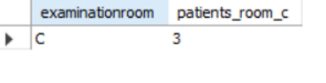
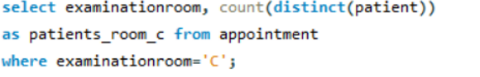
Name of the physician and the departments they are affiliated with
Count number of unique patients who got an appointment for examination room C

Slide 9
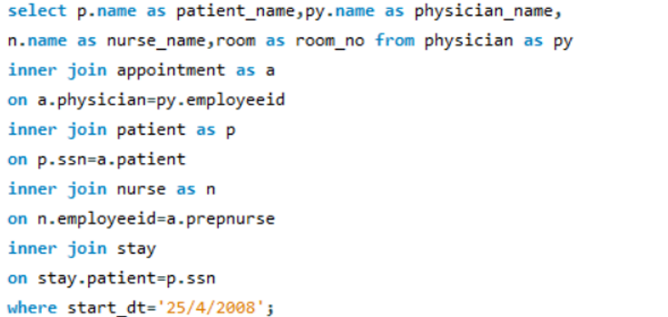
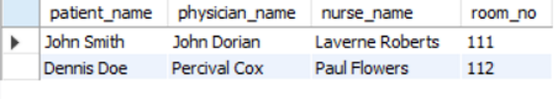
Name of the patients who taken the appointment on the 25th of April at 10 am, and also display their physician, assisting nurses and room no.

Slide 10
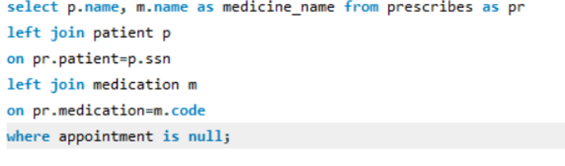
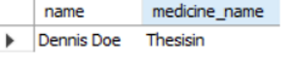
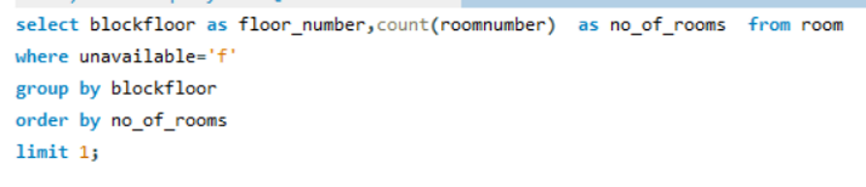
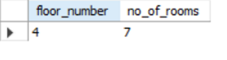
Name and medication for those patients who did not take any appointment
Floor where the minimum no of rooms are available

Slide 11
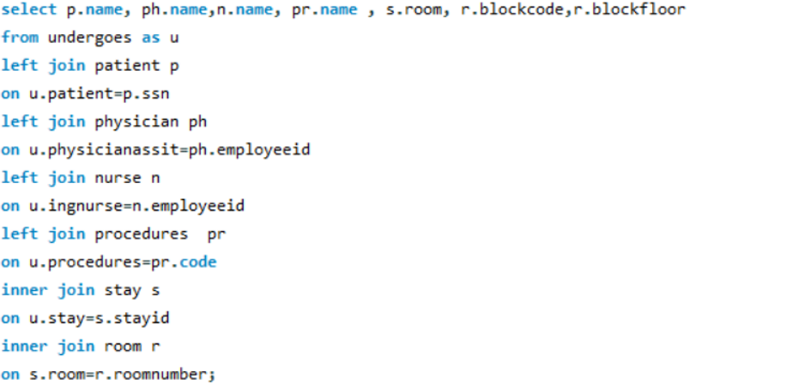
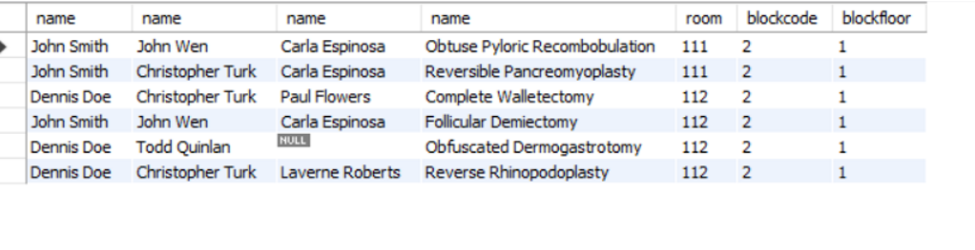
Name of the patient, name of the physician who is treating him or her, name of the nurse who is attending him or her, which treatment is going on to the patient, the date of release, in which room the patient has admitted and which floor and block the room belongs to respectively

Slide 12
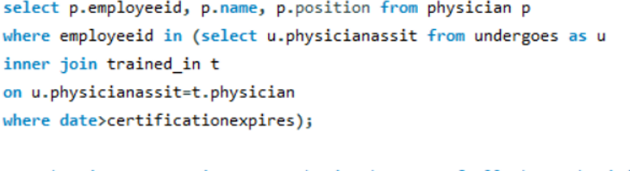
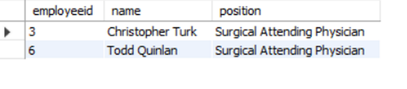
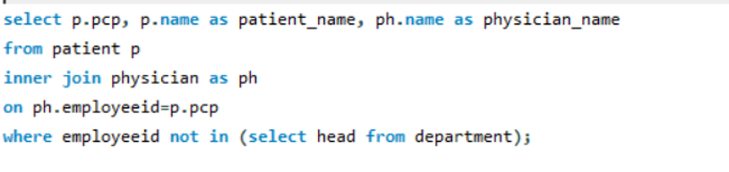
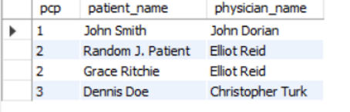
The name and position of all physicians who completed a medical procedure with certification after the date of expiration of their certificate.
Names of all patients whose primary care is taken by a physician who is not the head of any department and name of that physician along with their primary care physician.

Slide 13
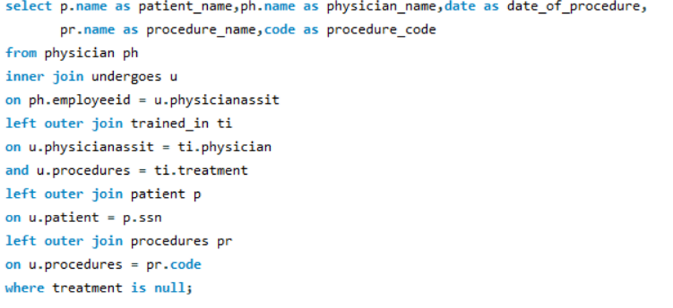
The names of all the physicians, their procedure, date when the procedure was carried out and name of the patient on which procedure have been carried out but those physicians are not citified for that procedure.

Slide 14
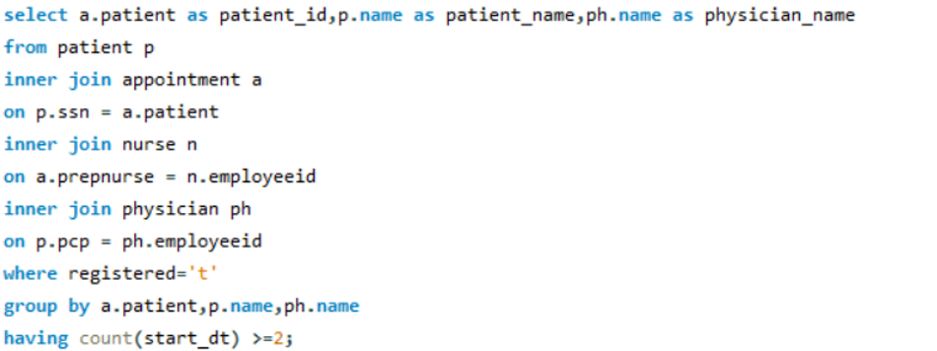
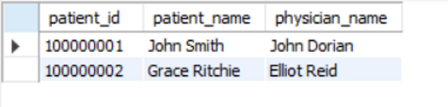
Names of all patients who had at least two appointment where the nurse who prepped the appointment was a registered nurse and the physician who has carried out primary care.

Slide 15


